Slide 1
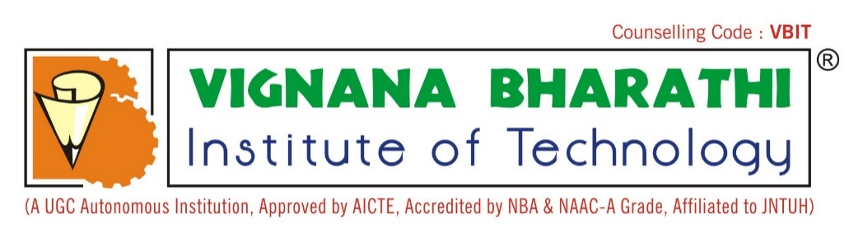
OPTIMIZING EMPLOYEE RETENTION WITH DEEP LEARNING-ENHANCED ATTRITION FORECASTING
Guide
MRS.M PARVATHI ASSISTANT PROFESSOR
GOURAV PATIL(22P65A6606)
NAMITHA REDDY(21P61A66F9)
V.SRINU(21P61A66I0)

Slide 2
CONTENT
ABSTRACT
EXISTING SYSTEM
PROPOSED SYSTEM
LITERATURE SURVEY
SYSTEM REQUIREMENTS

Slide 3
ABSTRACT
Employee attrition presents a formidable challenge for organizations, impacting both productivity and financial stability, with traditional statistical methods often inadequate in capturing its complex nature. This study pioneers an advanced predictive framework that synergistically integrates Convolutional Neural Networks (CNNs) and Long Short-Term Memory (LSTM) networks to elevate the accuracy of attrition forecasts. The innovative hybrid model leverages CNNs' proficiency in uncovering intricate feature interactions alongside LSTMs' capability to model temporal data sequences, thereby delivering a sophisticated analysis of attrition dynamics. Employing an advanced preprocessing pipeline and rigorous evaluation metrics—such as accuracy and ROC-AUC—the model surpasses conventional techniques, offering human resources departments actionable insights to precisely identify high-risk employees and implement targeted retention strategies, thereby enhancing overall workforce stability
KEYWORDS: Deep Learning, Convolutional Neural Networks(CNNs), Long Short-Term Memory(LSTM), Predictive Modeling, Hybrid Models, Hybrid Models, ROC-AUC, Advanced Preprocessing, Accuracy Metrics, Temporal Data Analysis, Attrition Forecasting, HR Analytics, Employee Attrition, Workforce Stability, Retention Strategies, Feature Engineering

Slide 4
EXISTING SYSTEMS
In this we used Machine Learning to predict Employee Attrition.
Therefore, the existing system for predicting employee attrition using machine learning techniques may be a basic statistical analysis or a manual process of tracking employee turnover.
DRAWBACKS
Takes more time.
No consideration of data quality issues: The study does not consider data quality issues, such as missing values, outliers, or errors in data collection, which may affect the accuracy of the models.
No consideration of external factors: The study does not consider external factors that may affect employee attrition, such as economic conditions, industry trends, or competitor activity.
Less Accuracy
Overfitting: There is a risk of overfitting when using complex models with many parameters, which can lead to poor generalization performance.

Slide 5
PROPOSED SYSTEM
Advanced DL Techniques: Exploring new techniques to improve prediction accuracy.
Reduces complexity
Reduces Time
In this we are using CNN and LSTM. By using this the result is a more accurate and actionable prediction, which can be used to implement targeted retention strategies.

Slide 6
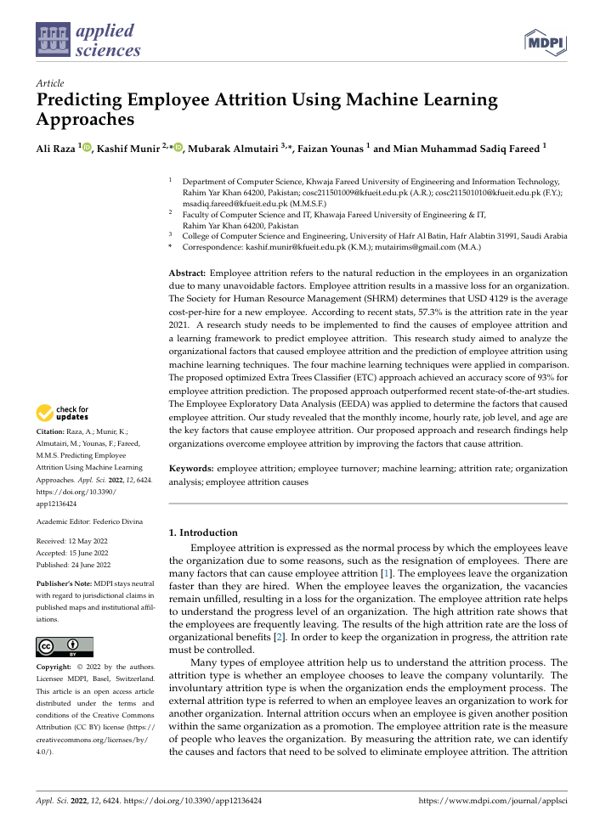
LITERATURE SURVEY
DESCRIPTION
In this we are using machine learning.
The machine learning algorithms used in this project are SVM, Logistic Regression, Decision Tree Classifier, Extra Trees Classifier.
The Synthetic Minority Oversampling Technique (SMOTE) is used to balance the dataset, which is essential for improving the accuracy of the machine learning models.
Our proposed approach and research findings help organizations overcome employee attrition by improving the factors that cause attrition.
The system performs Employee Exploratory Data Analysis (EEDA) to identify the key factors contributing to employee attrition. Factors like monthly income, hourly rate, job level, and age are identified as significant contributors to attrition.

Slide 7
SYSTEM REQUIREMENTS
Hardware Requirements:
Processor: Multi-core processor (e.g., Intel i7 or AMD Ryzen 7) for parallel processing and handling large dataset.
RAM: At least 32 GB of RAM, though 64 GB or more would be preferable to handle large datasets and memory-intensive operations during training..
Storage: Solid-State Drive (SSD) with at least 1 TB of storage, as deep learning models and datasets can be large and require fast read/write speeds.
GPU:A powerful GPU (e.g., NVIDIA RTX 3080/3090, NVIDIA A100, or Tesla V100) is crucial for training deep learning models, especially CNNs and LSTMs, which require extensive matrix computations.
Software Requirements:
Operating System: Windows 10 or Linux (Ubuntu 20.04 or later) for compatibility with deep learning frameworks.
Programming Languages: Python for implementing algorithms and models.
Libraries and Frameworks:
TensorFlow: A widely used open-source deep learning framework that supports both CNNs and LSTMs.
Keras: An API integrated with TensorFlow, useful for building and training deep learning models quickly.
NumPy: For numerical computations
Pandas: For data manipulation and preprocessing
OpenCV: If image data or complex feature extraction is involved, especially when using CNNs.
Matplotlib/Seaborn: For data visualization and plotting ROC curves, accuracy metrics, etc.
Development Tools: Jupyter Notebook for coding and testing.

Slide 8
THANK YOU

